Slide 1
Introduction
Is it correct or not ?

Slide 2
What is the bug ?
bug is an error, flaw, failure or fault in a computer program or system that causes it to produce an incorrect or unexpected result, or to behave in unintended ways. Most bugs arise from mistakes and errors made in either a program's source code or its design, or in components and operating systems used by such programs.
Bugs trigger errors that may have ripple effects.
Bugs may have subtle effects or cause the program to crash or freeze the computer.
Others qualify as security bugs and might

Slide 3
What is a bug ?
Bugs usually appear when the programmer makes a logic error. Various innovations in programming style and defensive programming are designed to make these bugs less likely, or easier to spot. Some typos, especially of symbols or logical/mathematical operators, allow the program to operate incorrectly, while others such as a missing symbol or misspelled name may prevent the program from operating. Compiled languages can reveal some typos when the source code is compiled.

Slide 4

What is a bug ? (cntd)
spec
Implementation

Slide 5
What is a bug ? (cntd)
How do you know that our spec is correct ?
The ___ about flight mode and WIFI depends upon what is written ?

Slide 6
Our Project
Have the definition of SPEC
Precise and formal

Slide 7
Our Project (Cntd.)
We build a tool to define and check consistency of SPECS

Slide 8
Problem summary
We took apps of cellular phones because they may be presented as transtions between screens using actions

Slide 9
Example
Screen diagram of BoPo
We want to build a tool that produces the screen diagram automatically and makes “sanity” check by .

Slide 10
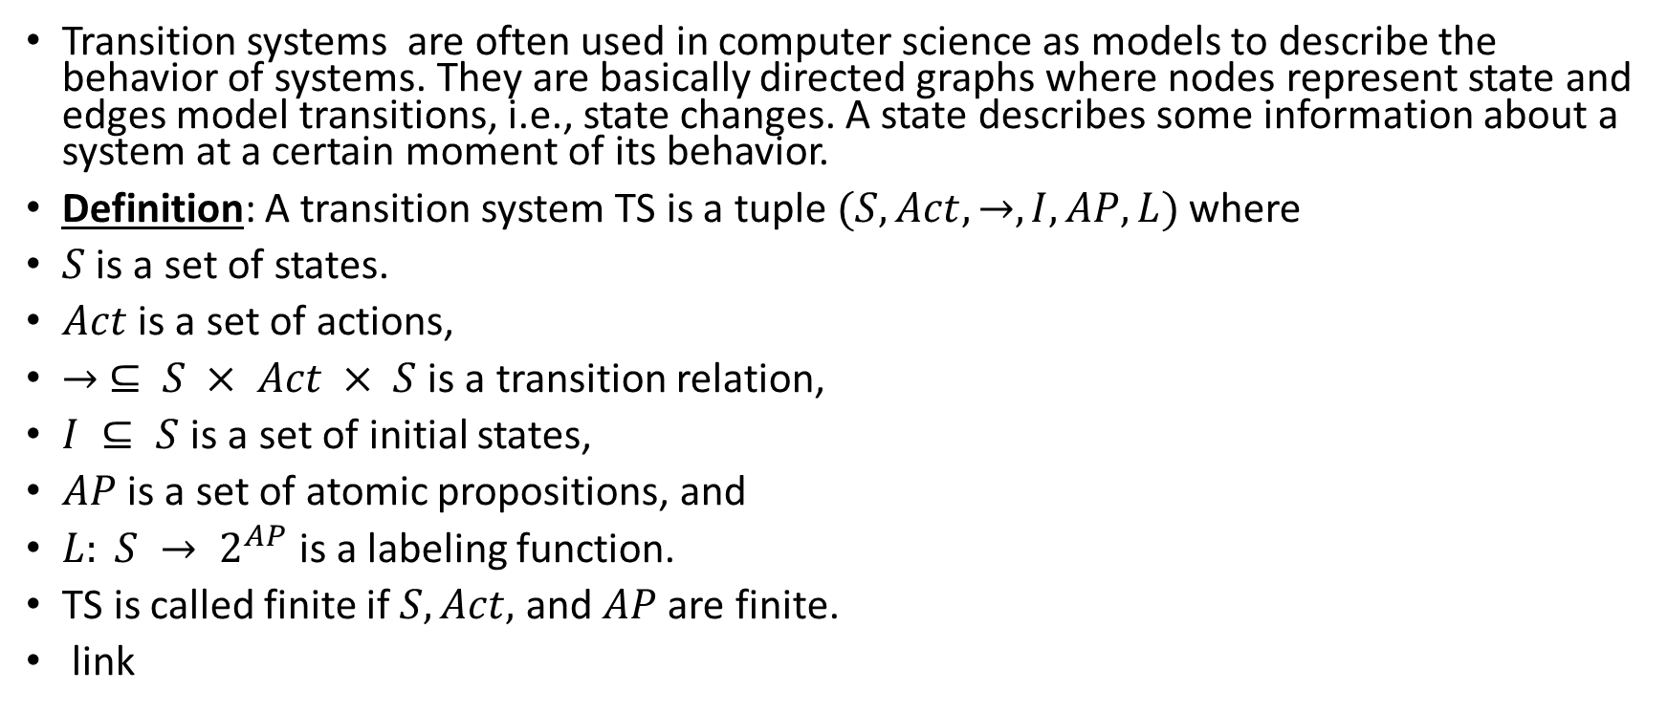
Transition System (TS)
Transition systems are often used in computer science as models to describe the behavior of systems. They are basically directed graphs where nodes represent state and edges model transitions, i.e., state changes. A state describes some information about a system at a certain moment of its behavior.
Definition: A transition system TS is a tuple $(S, Act, →, I, AP, L)$ where
$S$ is a set of states.
$Act$ is a set of actions,
$→ ⊆ S × Act × S$ is a transition relation,
$I ⊆ S$ is a set of initial states,
$AP$ is a set of atomic propositions, and
$L: S → 2^{AP}$is a labeling function.
TS is called finite if $S, Act,$ and $AP$ are finite.
link

Slide 11
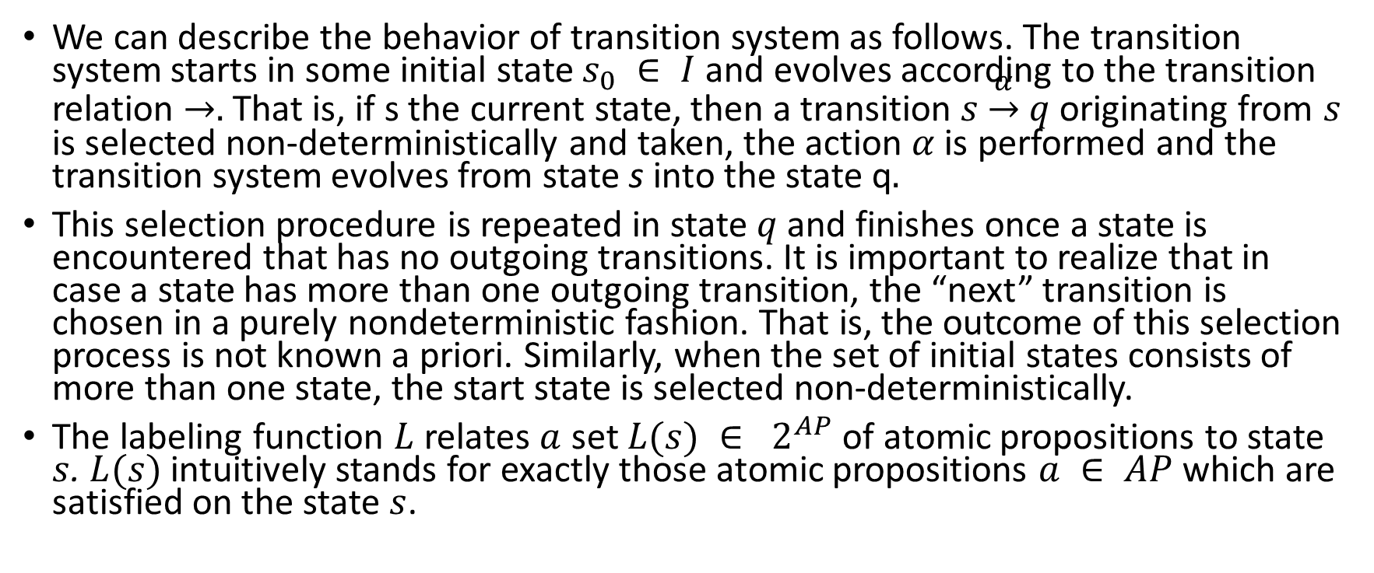
We can describe the behavior of transition system as follows. The transition system starts in some initial state $s_{0} ∈ I$and evolves according to the transition relation $→.$ That is, if s the current state, then a transition $s \underset{→}{α} q$ originating from $s$ is selected non-deterministically and taken, the action $α$ is performed and the transition system evolves from state s into the state q$.$
This selection procedure is repeated in state $q$ and finishes once a state is encountered that has no outgoing transitions. It is important to realize that in case a state has more than one outgoing transition, the “next” transition is chosen in a purely nondeterministic fashion. That is, the outcome of this selection process is not known a priori. Similarly, when the set of initial states consists of more than one state, the start state is selected non-deterministically.
The labeling function $L$ relates $a$ set $L(s) ∈ 2^{AP}$of atomic propositions to state $s$. $L(s)$ intuitively stands for exactly those atomic propositions $a ∈ AP$ which are satisfied on the state $s$.

Slide 12
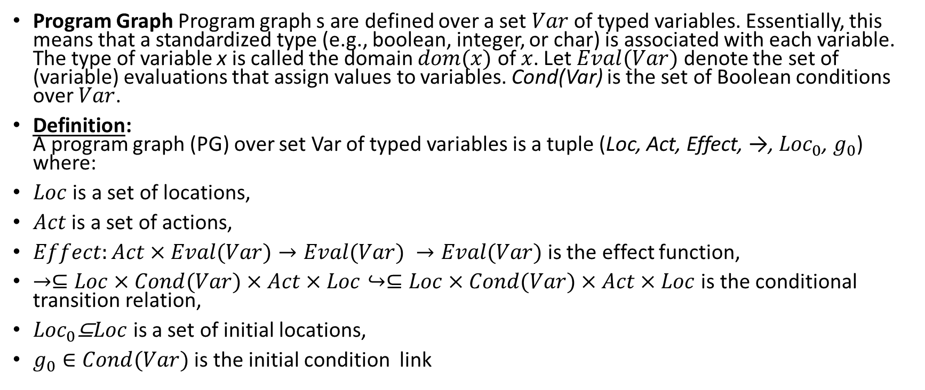
Program graph(PG)
Program Graph Program graph s are defined over a set $Var$ of typed variables. Essentially, this means that a standardized type (e.g., boolean, integer, or char) is associated with each variable. The type of variable x is called the domain $dom(x)$ of $x$. Let $Eval(Var)$ denote the set of (variable) evaluations that assign values to variables. Cond(Var) is the set of Boolean conditions over $Var$.
Definition: A program graph (PG) over set Var of typed variables is a tuple (Loc, Act, Effect, →, ${Loc}_{0}$, $g_{0}$) where:
$Loc$ is a set of locations,
$Act$ is a set of actions,
$Effect:Act×Eval(Var)→Eval(Var) →Eval(Var)$is the effect function,
$→⊆Loc×Cond(Var)×Act×Loc↪⊆Loc×Cond(Var)×Act×Loc$ is the conditional transition relation,
${Loc}_{0}$⊆$Loc$ is a set of initial locations,
$g_{0}∈Cond(Var)$ is the initial condition link

Slide 13
Program graph example

Slide 14
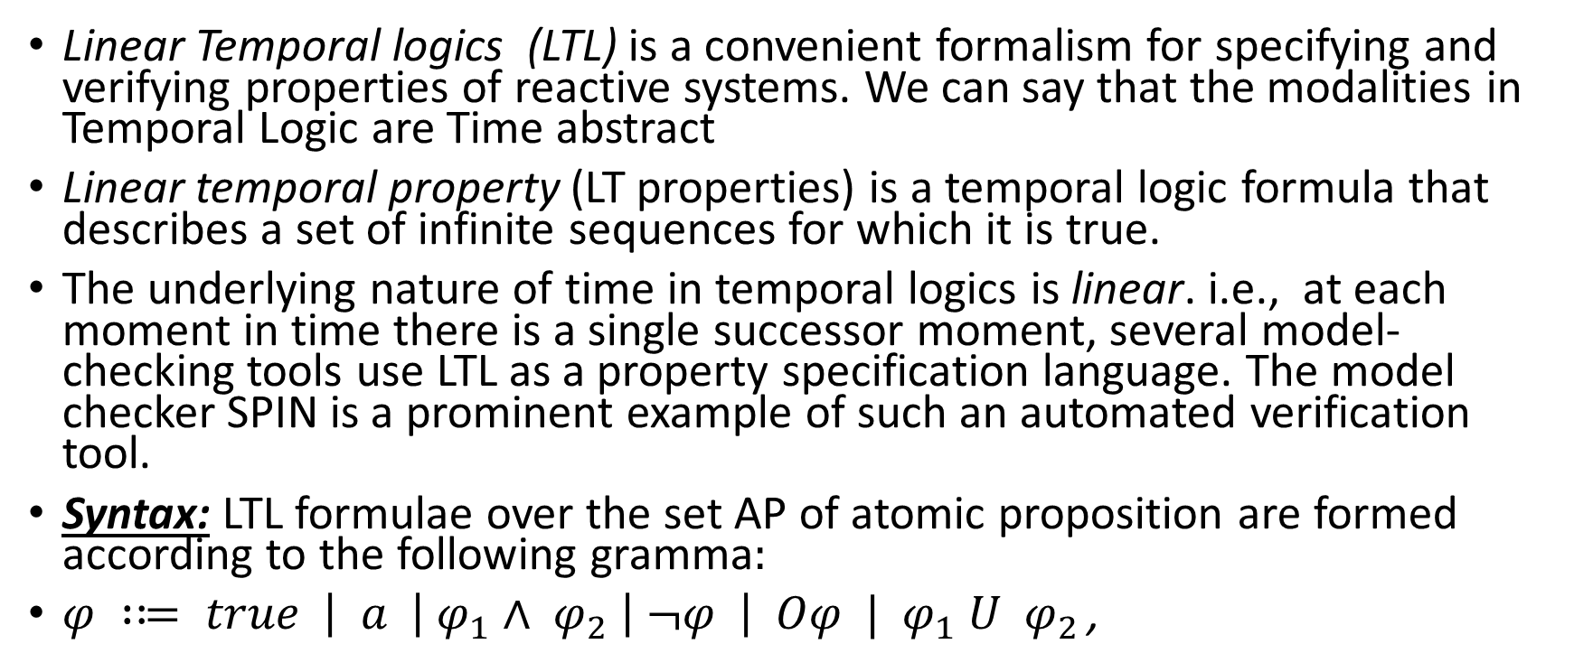
Linear Temporal Logic
Linear Temporal logics (LTL) is a convenient formalism for specifying and verifying properties of reactive systems. We can say that the modalities in Temporal Logic are Time abstract
Linear temporal property (LT properties) is a temporal logic formula that describes a set of infinite sequences for which it is true.
The underlying nature of time in temporal logics is linear. i.e., at each moment in time there is a single successor moment, several model-checking tools use LTL as a property specification language. The model checker SPIN is a prominent example of such an automated verification tool.
Syntax: LTL formulae over the set AP of atomic proposition are formed according to the following gramma$:$
$φ :≔ true \left| a \left|{ φ}_{1} ∧ φ_{2} \right| ¬φ \right| Οφ | { φ}_{1} U{ φ}_{2 }$,

Slide 15
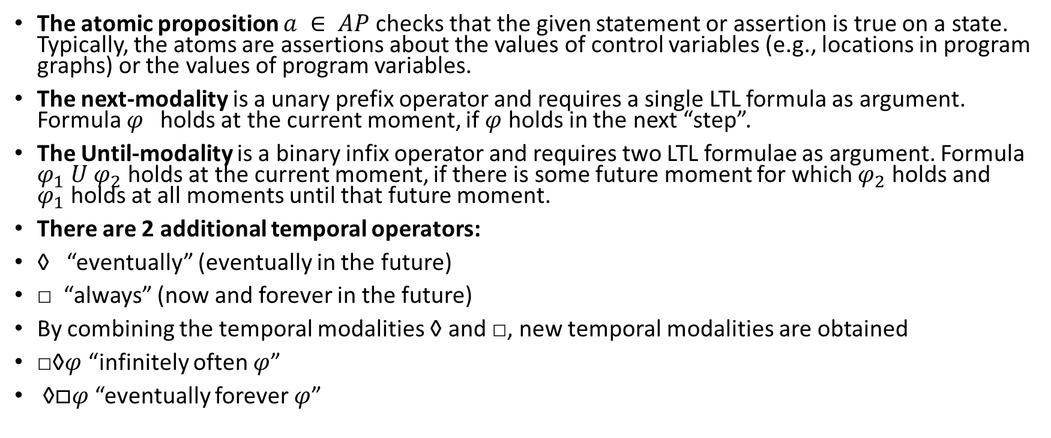
Linear Temporal Logic (cont.)
The atomic proposition $a ∈ AP$checks that the given statement or assertion is true on a state. Typically, the atoms are assertions about the values of control variables (e.g., locations in program graphs) or the values of program variables.
The next-modality is a unary prefix operator and requires a single LTL formula as argument. Formula $φ$holds at the current moment, if $φ$ holds in the next “step”.
The Until-modality is a binary infix operator and requires two LTL formulae as argument. Formula $φ_{1} U{ φ}_{2}$ holds at the current moment, if there is some future moment for which $φ_{2}$holds and $φ_{1}$holds at all moments until that future moment.
There are 2 additional temporal operators:
◊ “eventually” (eventually in the future)
□ “always” (now and forever in the future)
By combining the temporal modalities ◊ and □, new temporal modalities are obtained
□◊$φ$ “infinitely often $φ$”
◊$□φ$ “eventually forever $φ$”

Slide 16
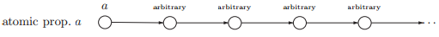
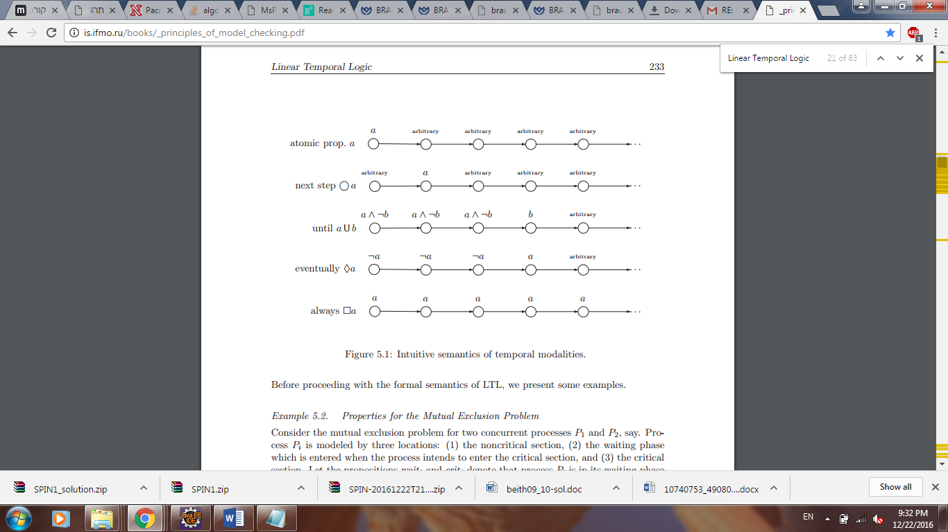

Semantics of LTL over Paths and States:
$a$ has to hold at the current state
a has to hold at the next state
a has to hold until b , which holds at the current or a future position
a has to hold on the entire subsequent path
A eventually has to hold (somewhere on the subsequent path);

Slide 17
Spin
Spin is a popular verification tool of distributed systems, used by thousands of people worldwide. It was developed at Bell Labs in the UNIX group of the Computing Sciences Research Center, starting in 1980.
The tool can be used for the formal verification of multi-threaded software applications. Spin can perform simulations of the system's execution. Spin can perform interactive, guided, or random simulations of the system's execution.

Slide 18
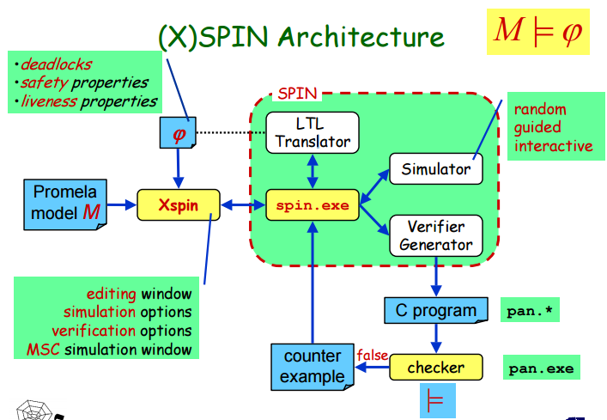
SPIN

Slide 20
Spin : The PROMELA language
PROMELA (Process or Protocol Meta Language) is a verification modeling language.
The language allows for the dynamic creation of concurrent processes to model, for example, distributed systems. In PROMELA models, communication via message channels can be defined to be synchronous or asynchronous.
PROMELA models can be analyzed with the SPIN model checker, to verify that the modeled system produces the desired behavior.
link

